Slide 1

CREDIT CARD
WEEKLY
SALES REPORT
by Riddham Jain

Slide 2
Contents
Project objective
Data from SQL
Data processing & DAX
Dashboard & insights
Export & share project

Slide 3
Project Objective
To develop a comprehensive credit card weekly dashboard that provides
real-time insights into key performance metrics and trends, enabling
stakeholders to monitor and analyze credit card operations effectively.
Download Data
GitHub:
https://github.com/Jainriddham/Credit_Card_Financial_Dashboard

Slide 4
Import data to SQL database
Prepare csv file
Create tables in SQL
import csv file into SQL
NOTE: Find all SQL queries & project data-
https://github.com/Jainriddham/Credit_Card_Financial_Dashboard

Slide 5
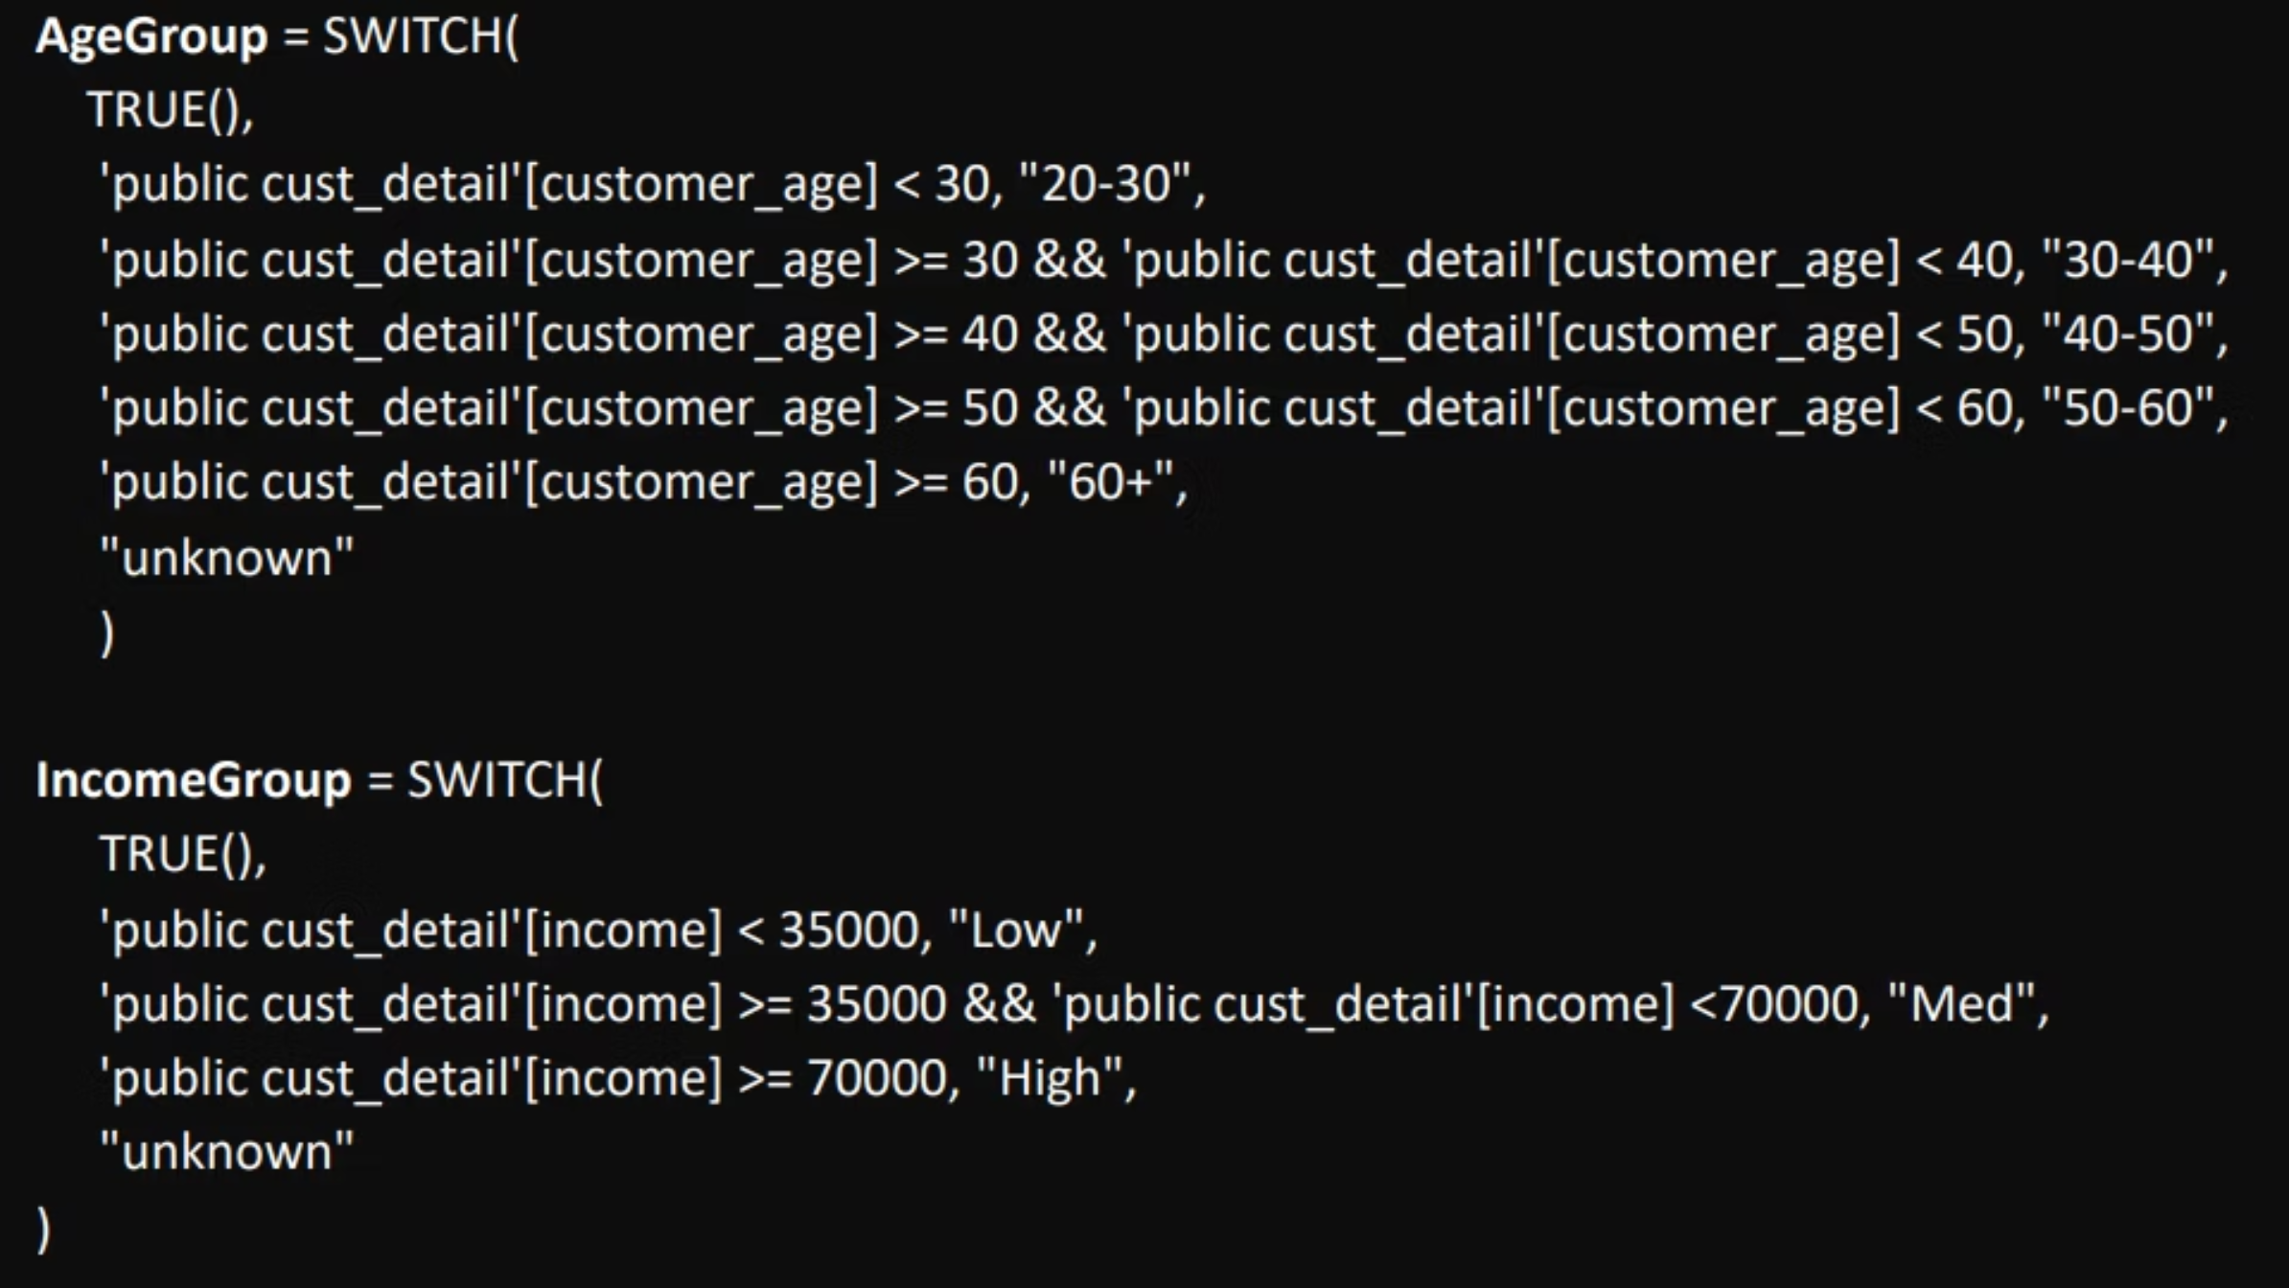
DAX Queries

Slide 6
Project Insights- Week 53 (31st Dec)
WoW change:
Revenue increased by 28.8%,
Total Transaction Amt & Count increased by xx% & xx%
Customer count increased by xx%
Overview YTD:
Overall revenue is 57M
Total interest is 8M
Total transaction amount is 46M
Male customers are contributing more in revenue 31M, female 26M
Blue & Silver credit card are contributing to 93% of overall transactions
TX, NY & CA is contributing to 68%
Overall Activation rate is 57.5%
Overall Delinquent rate is 6.06

Slide 7
THANK YOU
FOLLOW FOR MORE DATA ANALYTICS RESOURCES
LinkedIn: www.linkedin.com/in/ridjain29

